Slide 1
Bicycle Rental System
Presented To
Tasniya Ahmed
Lecturer Of IIT, NSTU
Presented By
Name: Md Mynuddin
ID: ASH1825007M
Name: Kamruzzaman Sekh
ID: ASH1825035M

Slide 2
System Overview
In the modern time people want to lead an easy life in every sector. For digitalization people can save their time in every sector in their life. In the present time there have many ways to lead a better life.
However, sometimes student have too much urgent works . They need to go one place to another faster or other purpose, but they can’t. So build a system that,
A registered user or biker can rent a bicycle : He or she just login and search bicycle ,biker can see bicycle available or not, if available choose one , can book this and pay the payment by per hour. Enjoy the ride. And back the cycle to the park ☺.
Admin : Handle the payment process , bicycle add , bicycle remove , view user list, booking list, view cycle list.

Slide 3
Functional Requirement
Biker can Search Bicycle by Brand Name.
Add Bicycle by admin.
Remove Bicycle by admin.
User can Booking Bicycle.
View Booking list .
View User Information By admin.

Slide 4

Use Case Diagram
Login
Add Cycle
Remove Cycle
View Cycle List
Admin
View User List
View Booking List
Payment Process
Logout

Slide 5

Use Case Diagram
Login
Search Bicycle
Bicycle Booking
Confirm Booking
Registered User
View Booking
Cancel Booked Cycle
Payment
Logout

Slide 6
Language Used in System
HTML – For Structuring.
CSS – For Styling
Bootstrap – For Styling
Php - For Programming.
MySQL – For Database.
JavaScript – For User interactivity

Slide 7
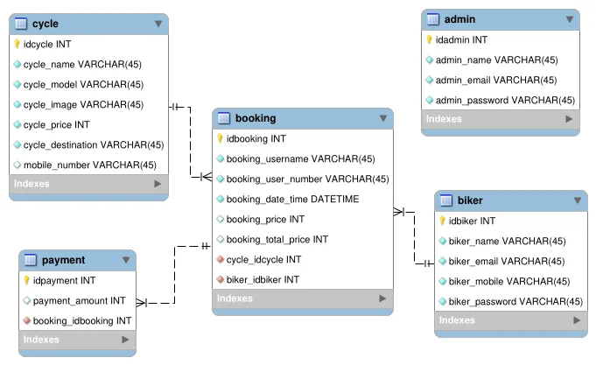
ER Diagram

Slide 8
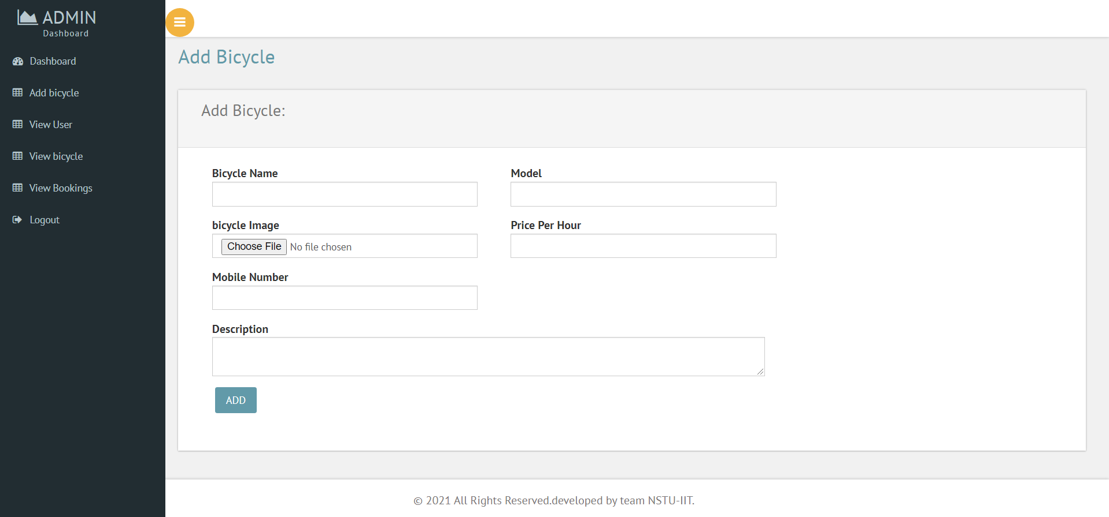
System Feature

Slide 9
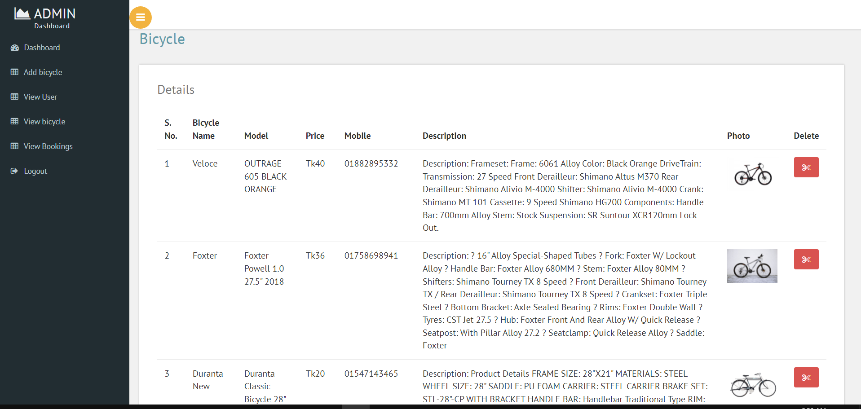
System Feature

Slide 10
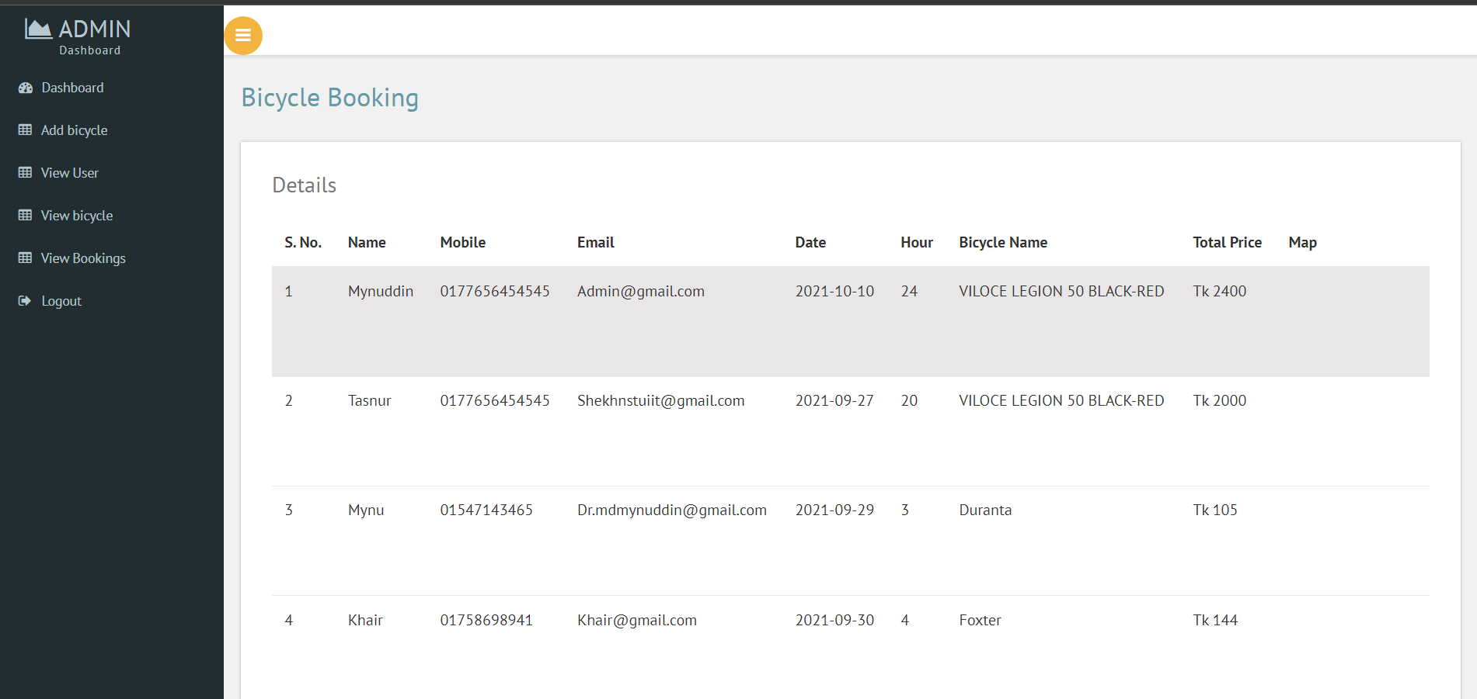
System Feature

Slide 11
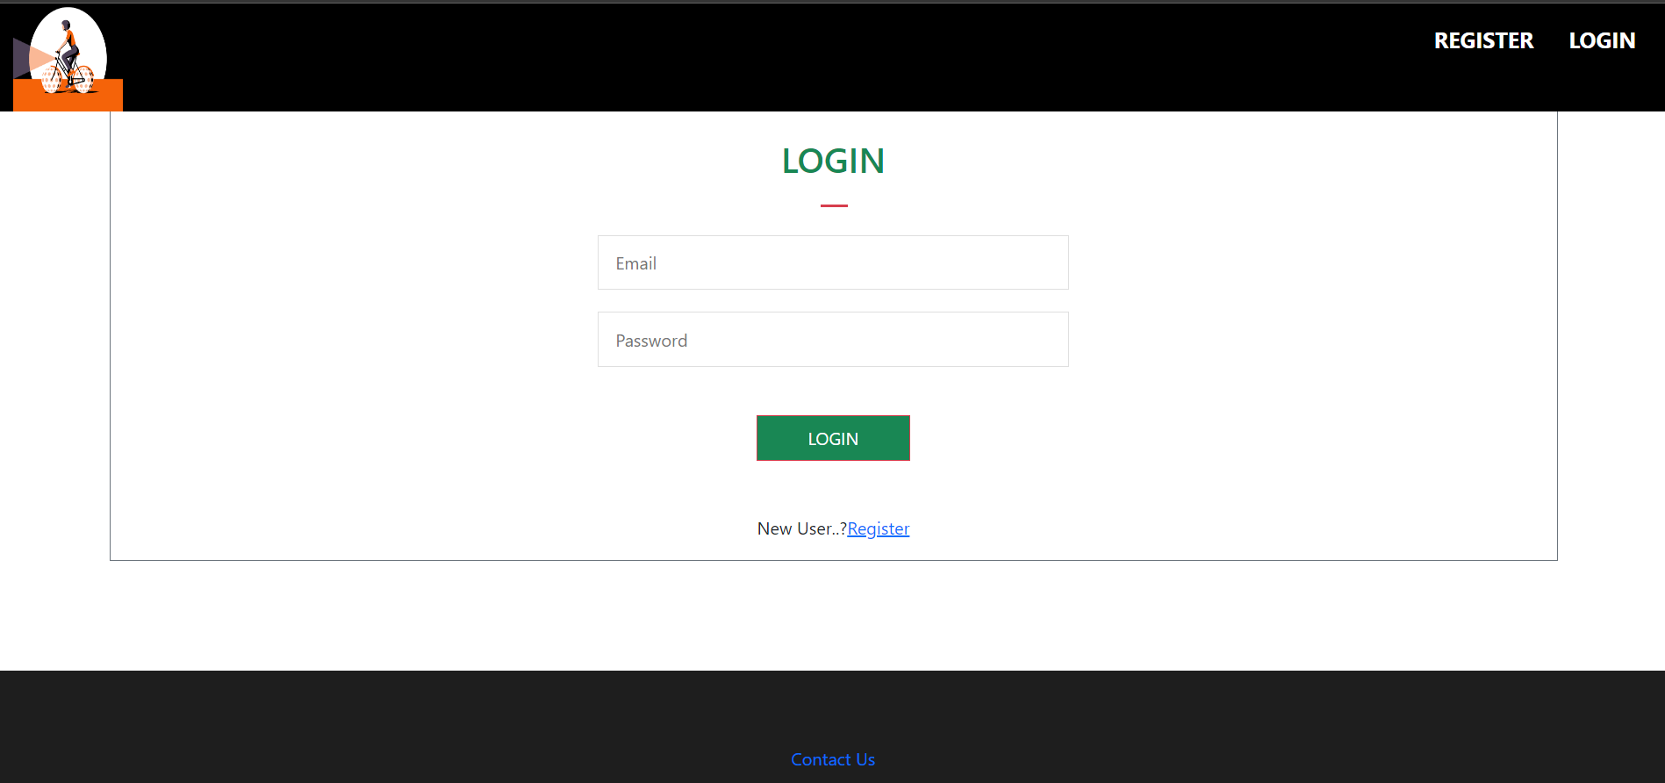
System Feature

Slide 12
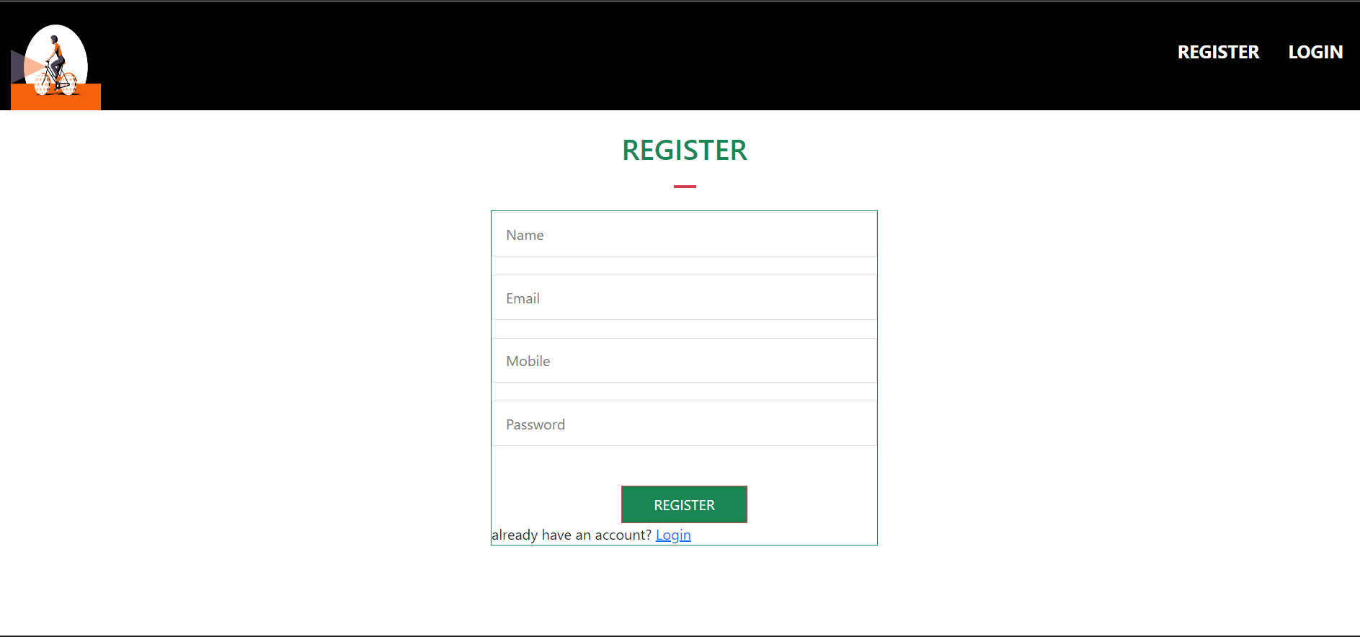
System Feature

Slide 13
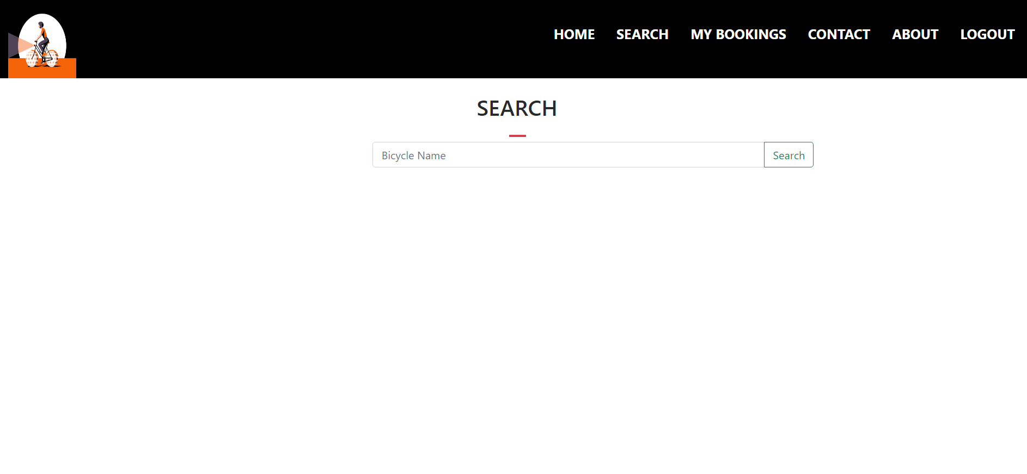
System Feature

Slide 14
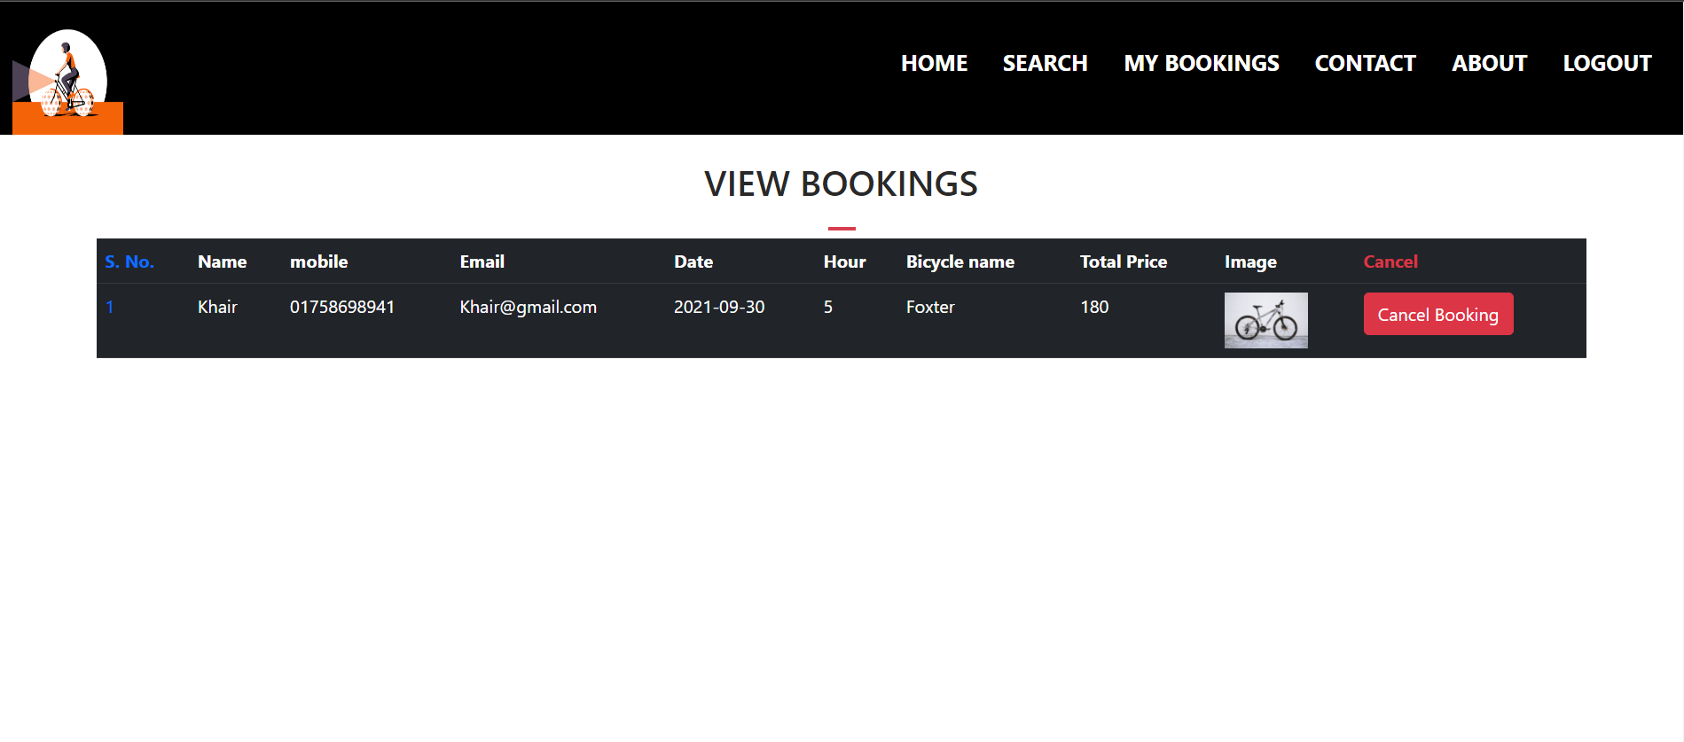
System Feature

Slide 15
Future Feature or Functionality
User Interface Design Update.
Payment Functionality.
Android Application.
Unlock By QR code Scanning Option.
Automatic Time count Option.

Slide 16
☺ Thanks To Everyone ☺

